Slide 1



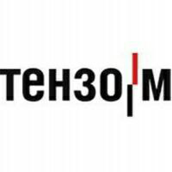
INVESTMENT PASSPORT
Lyubertsy city district
2019

Slide 2
Demographics and Resources
Lyubertsy city district is located
18 km southeast of the center of Moscow.
Borders on various sides with the city of Moscow, the urban districts of Balashikha, Kotelniki, Dzerzhinsky, Lytkarino, in the southeast with the Ramensky municipal district.
The area of ​​the urban district is 12,231 thousand hectare.
Administrative center - Lyubertsy city
The able-bodied population is 173 thousand people.
The economy of the district employs 96.8 thousand people.
Minerals: quartz sand
Cadastral value of land for placement:
• houses (individual housing construction): from 1900 - up to 5303 rubles per sq.m.
• summer cottage and horticultural associations: from 1413 to 4655 rubles. per sq.m.
• objects of trade: 5620 rubles. per sq.m.
• industry: 5050 rubles. per sq.m.
Average monthly salary (thousand rubles)
• industry 49.2
• construction 55.2
• trade 43.8
• education 47.9
• healthcare 59.9
• culture 45.4
• sport 49.2
Cost (without value added tax):
• Electricity: from 3.3 - to 4.71 rubles. for 1 kW / hour
• Gas supply: 4.91 - 5.56 rubles / cubic meter
• Water supply: from 28.56– to 34.69 rubles. per 1 cubic meter,
• Water disposal: from 27.17– to 33.8 rubles. per 1 cubic meter,
• Heat supply: from 1498.31– to 2118.0 rubles / gigacalorie

Slide 3
Transport connection
Currently, the main transport links of the residents of the Lyubertsy urban district with Moscow and the region are carried out by two modes of transport: rail (via the Moscow-Ryazan railway) and automobile (via a network of highways of federal, regional and municipal significance). The distribution of the values ​​of the total entry and exit to the territory of the Lyubertsy urban district by means of transport during rush hour exceeds certain traffic indicators by more than three times (determined by the joint borders with the city of Moscow, an increase in the density of residential buildings and an increase in the motorization of the population), in addition, There is a slight decrease in the volume of rail transport, while public ground and passenger individual transport are taking on an ever-increasing load. The Moscow-Ryazan railway passes through the central part of the district within its existing borders and is currently represented by three main routes along which trains in suburban passenger, freight and long-distance passenger traffic are provided. About half of the district’s territory is located within walking distance from the railway stopping points of the railway located within its borders: Lyubertsy-1, Art. Lyubertsy-2, pl. Punks Square Tomilino, pl. Kraskovo, pl. Malakhovka, pl. Korenevo. For a day, about 250 pairs of passenger electric trains provide direct communication with the cities of Moscow, Ramenskoye, Golutvin, Kolomna, Ryazan. Passenger traffic following the railway stopping points located within the boundaries of the okrug is almost uniform, as there is the possibility of a transfer from railway transport to city and intermunicipal road transport, which makes it possible to use railway transport not only within walking distance. The main burden on passenger transportation falls on road transport. The district’s motor transportation links with Moscow are provided through a network of federal, regional and municipal highways represented by the federal highway M-5 Ural, regional highways: Moscow-Zhukovsky, Moscow-Yegoryevsk-Tuma-Kasimov, "Khlystovo-Marusino - Motyakovo - N. Milet", "Nekrasovka - Zenino - Marusino" and municipal roads.

Slide 4
Education and skilled personnel
The network of municipal educational organizations of the district includes:
46 preschool educational organizations;
42 general educational organizations (3 lyceums, 11 gymnasiums, 23 secondary schools, 2 basic, 1 Cadet school, 1 open shift school);
2 special correctional institutions; -
an institution for children of orphans and children without parental care of the boarding school "Our Home";
3 institutions of additional education for children;
Diagnostic and counseling center;
Center for the Development of Family and Children in Need of Psychological, Pedagogical and Medical and Social Assistance "Hope";
Social center
labor adaptation and career guidance;
Education Development Center.
The total number of students in municipal educational institutions is 24552 people and 16000 pupils in kindergartens. The number of teaching staff of subordinate municipal educational institutions is 2828.

Slide 5
Industrial companies of the urban district of Lyubertsy
On the territory of the district 100 large and medium-sized enterprises operate, of which 37 are industrial enterprises. The most significant enterprises of the region are: Kamov OJSC, Kamov Service CJSC, NPO Zvezda OJSC, and Moscow Helicopter Plant named after M.L. Milya, an affiliate of MSI OJSC Lyubertsy Bridge Construction Equipment Plant, PK Leader LLC, NPP Tomilinsky Electronic Plant LLC, ElTom NPP OJSC, Laguna Coil LLC , LLC NPF Tehenergokompleks, LLC PKO Atesi, LLC Pehor Textile, CJSC Weighting Company Tenzo-M, LLC NPF Trekol, LLC “Confectionery factory“ Volshebnitsa ”, CJSC“ FPG Energocontract ”, LLC“ Textile-Innovation ”, LLC Kitchen“ Trivoli ”, CJSC“ Medical Technologies Ltd ”. The enterprises produce helicopters, spacesuits and life support systems for astronauts, ejected chairs, furniture, building materials, agricultural machines, trade equipment, special clothing for firemen, oil workers, geologists, polar explorers and miners, confectionery, soft drinks, deli meats, synthetic fabrics, yarn, medical equipment, etc.
On the basis of the Lyubertsy Montazhavtomatika plant, the Lyubertsy technology park was opened.
A project for the construction of the Leader industrial park in Malakhovka has been implemented. The first resident of the technopark was General Electric, which transferred its production from Moscow to us. The opening ceremony of the technopark was attended by the Governor of the Moscow Region A.Yu. Vorobyov. The plant produces resuscitation systems for carrying premature babies, computer tomographs, and ultrasounds. The territory of the scientific and production complex of Medical Technologies Ltd CJSC is an industrial park, which should practically become the center of modern high-tech innovative enterprises engaged in the development and production of diagnostic medical equipment with a high degree of visualization. It is planned to prepare specialized research and testing laboratories, a scientific and technical center, X-ray-proof boxes, and a center for the collective use of equipment. Creation of conditions for modeling and building the entire chain from an idea and a prototype to small-scale and serial production of high-tech diagnostic medical equipment. The created cluster will turn into a serious tool for implementing the plans of the Government of the Russian Federation on import substitution in the field of the medical industry.

Slide 6
Industrial companies of the urban district of Lyuberts
Tomilino LLC (technological complex) operates in the district, the first large-scale project in Russia, combining a logistics center, a warehouse terminal and an industrial site with developed infrastructure.
Of great importance for the economy of the region is the construction of the engineering and technical center of CJSC Russian Helicopters, which will combine the scientific and production potentials of the Moscow Helicopter Plant named after Mile and the Kamov Center CJSC company will create about 3 thousand new jobs and attract investment in the regional economy.
The constructed Russian-Italian Helivert plant, part of the Helicopters of Russia holding, has one of the most modern production complexes in Russia, where the most advanced technologies have been introduced. Along with the serial production of helicopters, in the middle of this year, a service center for their maintenance will begin its work.
The production of innovative products is also carried out by CJSC NPP Zvezda named after Academician G.I. Severin. Among the latest achievements of the team are safety helmets with target designation and indication systems at the level of the best foreign developments. To save the pilots of light-engine aircraft, an ultralight compressed air system that has no analogues in the world has been created.
A radical reconstruction and comprehensive modernization of the Lyubertsy Montazhavtomatika Plant is underway, followed by its conversion to the release of new high-tech innovative products. After the enterprise reaches full capacity, more than a thousand people will work here.
One of the largest advertising and production companies in Moscow and the Moscow Region, LaserStil launched production of promotional products in the village of Mashkovo.
Confectionery company "Flight" has opened a new production hall in Lyubertsy.
The modernization and technical re-equipment of production began at the Pechorsky Textile enterprise in Tomilino.

Slide 7
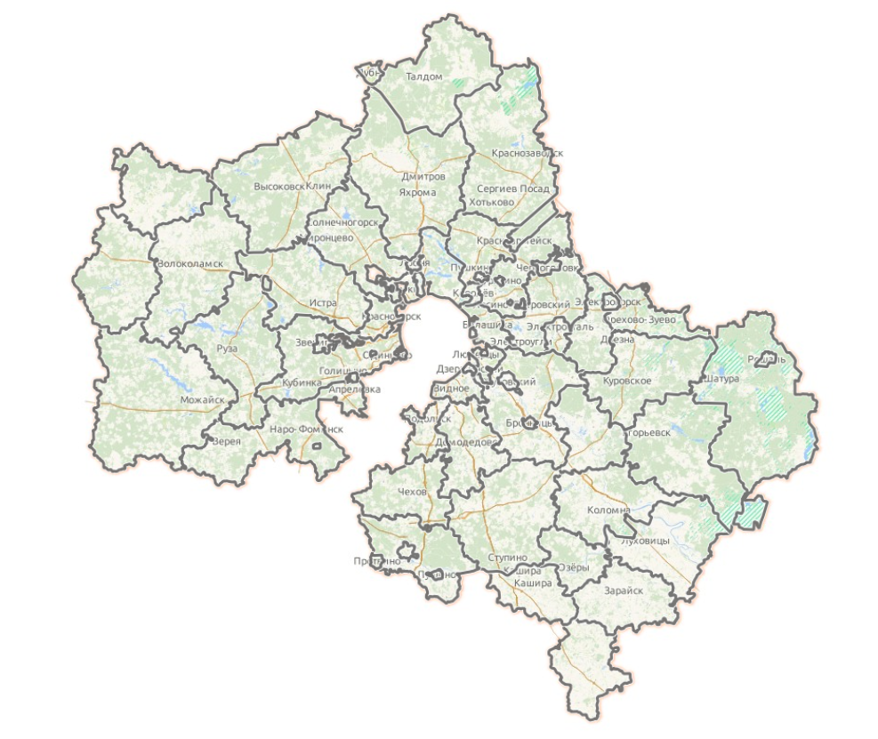
Indicators
Lyubertsy
The total area of ​​the district is 12,205 ha
Land settlements (40%).
Population 318.3 thousand
Population Density 2,571.52 people / km²
There are more than 14 thousand subjects of small and medium business.
Large and medium enterprises 100

Slide 8
Industrial enterprises
СJSC NPP Zvezda named after Academician G.I.Severin "
HeliVert СJSC
CJSC "Weighting company" Tenzo - M "
LLC Engineering company ATESI
CJSC "Lyubertsy Montazhavtomatika Plant"
Branch of Mostostroy Industry OJSC Lyubertsy Bridge Construction Equipment Plant
LLC Scientific and Industrial Firm "TREKOL"
LLC NPF Tehenergokompleks
LLC "RPK" Laser Style "
LLC RG-group
NPO ENERGOKONTRAKT JSC
Pehor Textile LLC
LLC TO Monolith
LLC PK "LEADER"
LLC "Lyubertsy Car Repair Plant"
LLC NGO "Association KILAK"
LLC InterLek
LLC "Kitchen yard"
Branch of JSCB “SLAVIA” (OJSC) Lyubertsy
C JSC "Lyubertsy bakery"

Slide 9


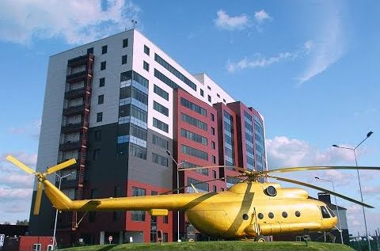
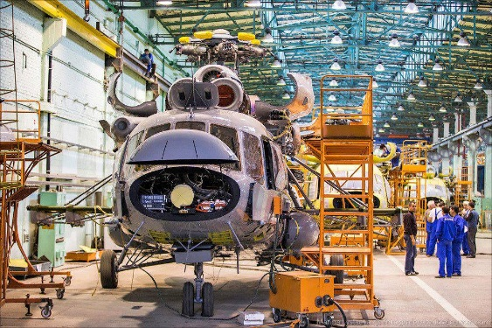

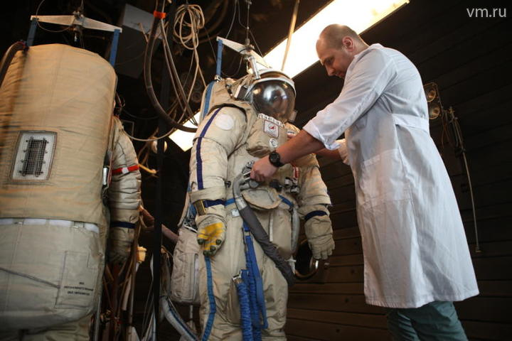
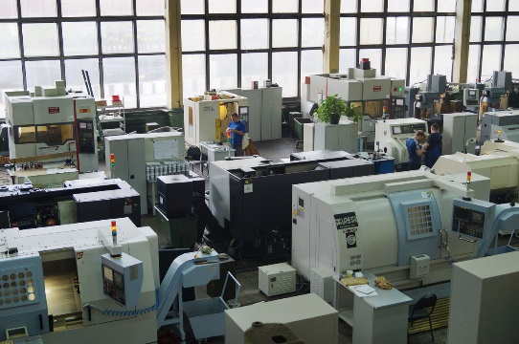
Investment passport of the city district of Lyubertsy
CJSC Moscow Helicopter Plant. M. L. Mil. The plant is engaged in experimental design and research work, design, construction and testing of prototypes of helicopters. It is an important link in the industry association Russian Helicopters.
CJSC Research and Production Enterprise Zvezda named after G. I. Severin. The leading enterprise in Russia in the field of creating and manufacturing individual life support systems for pilots and astronauts, rescue crews and passengers in case of aircraft accidents, in-flight refueling systems for aircraft.

Slide 10

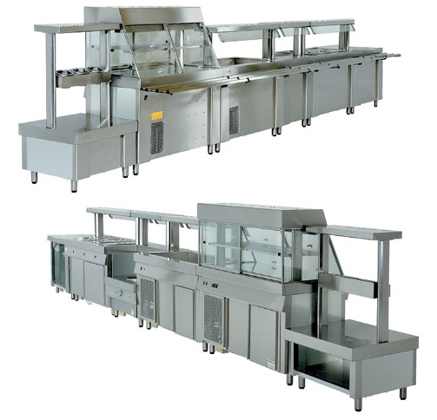
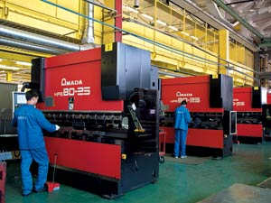



Investment passport of the city district of Lyubertsy
Machine-building company LLC ATESI One of the leading enterprises in Russia in the field of design and production of professional kitchen equipment. The company has created its own design and technological department, a quality department and a testing laboratory, which allows us to design, test and develop new products in the shortest possible time.
Textile Association "Monolith" Russian textile company, founded in 1992. The company is a member of the Russian Union of Entrepreneurs of Textile and Light Industry.

Slide 11

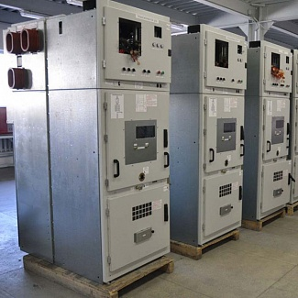
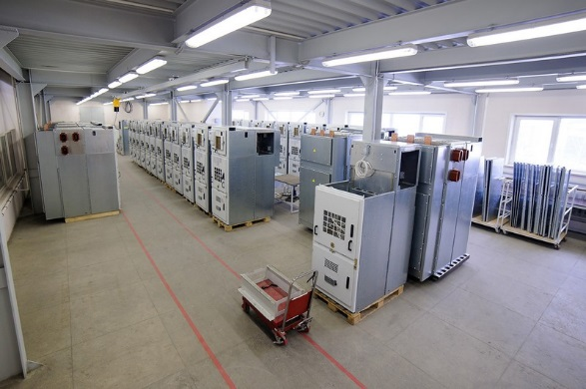

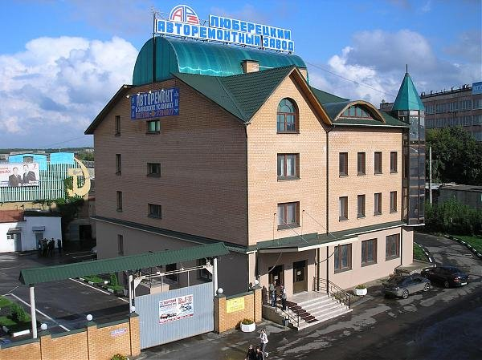
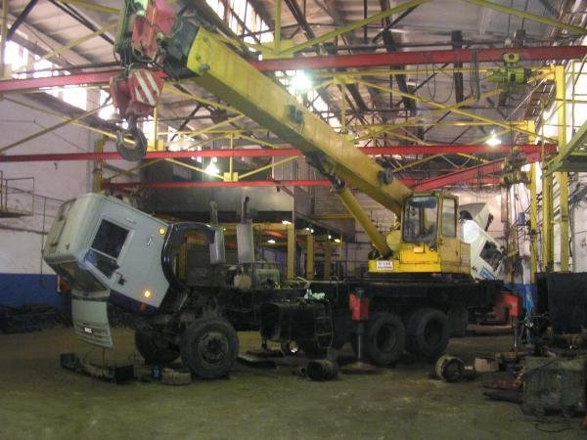
Investment passport of the city district of Lyubertsy
LLC NPF Tehenergokompleks the main activity is the development and serial production of modern and high-quality electrical equipment of voltage class up to 10 kV.
LLC "Lyubertsy Car Repair Plant" carries out the whole range of works on the repair of any domestic cars and foreign cars. The presence of its own machine tool base, as well as highly qualified specialists who are able to repair, restore or rebuild any part of the car.

Slide 12

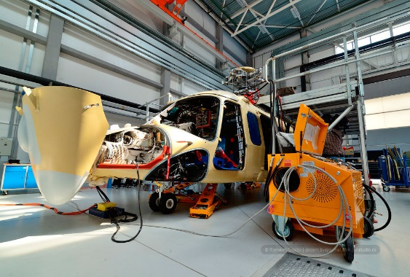
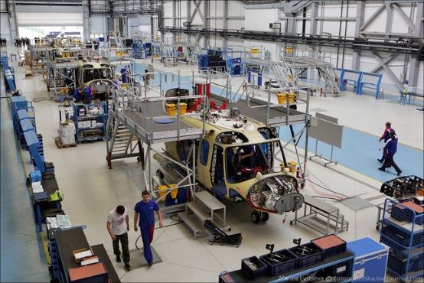
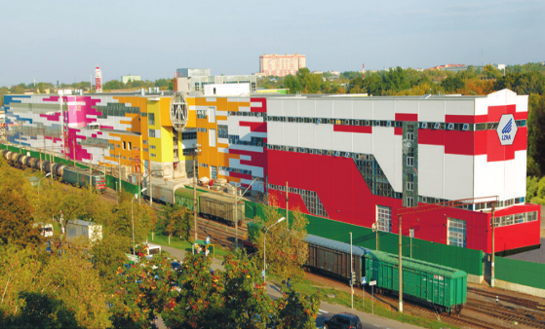
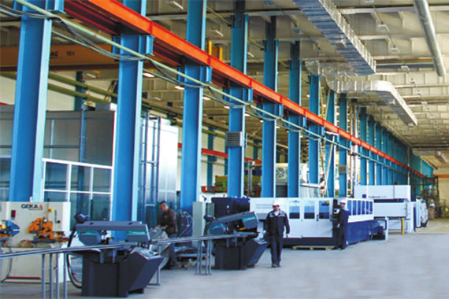
Investment passport of the city district of Lyubertsy
HeliVert CJSC is a joint venture of Helicopters of Russia CJSC and Leonardo S.p.A Helicopter Division PJSC HeliVert PJSC is a young, dynamically developing company that offers the new generation multi-purpose helicopter AW139 on the Russian aviation market.
Lyubertsy Zavod Montazhavtomatika (CJSC LZM) is the first cluster in the Russian Federation of products for electric transport and power engineering, combining within the structure production, fundamental developments and modern systems for designing new products, organization of preparation for their production.

Slide 13

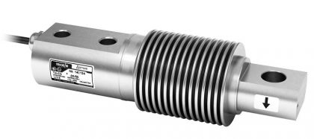
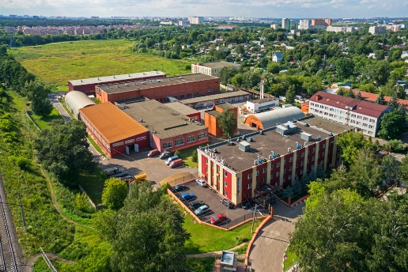
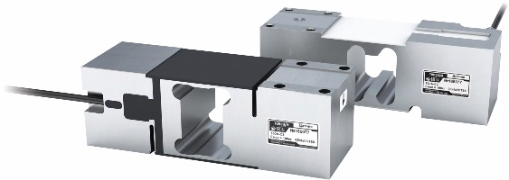

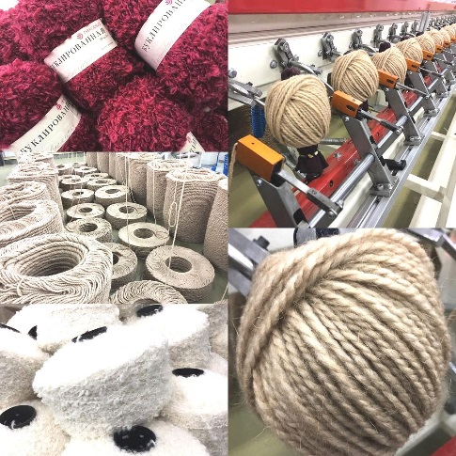
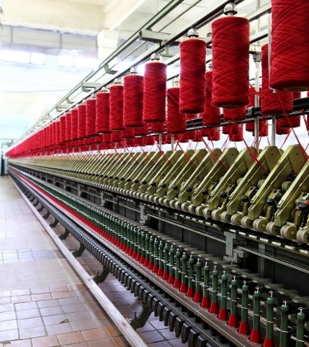
Investment passport of the city district of Lyubertsy
CJSC "VIK" Tenzo-M "Weighting company" Tenzo-M "is a leading Russian developer and manufacturer of industrial weighing equipment. Today, the company annually produces tens of thousands of load cells, scales, dispensers and secondary instruments for many industries.
Pehor Textile LLC is an enterprise producing yarn for hand and machine knitting. For the production of high-quality, sought-after yarn, the company was repeatedly awarded at international Textilexpo fairs with diplomas for high consumer properties of products. The company is included in the Register of 500 Successful Companies of Russia.

Slide 14

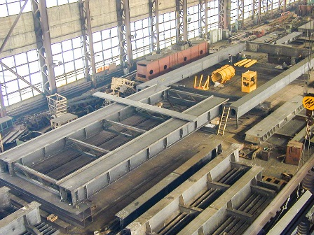
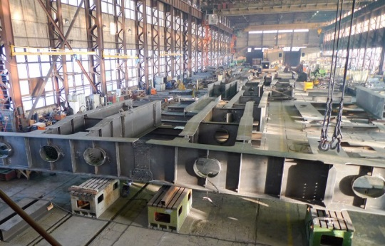

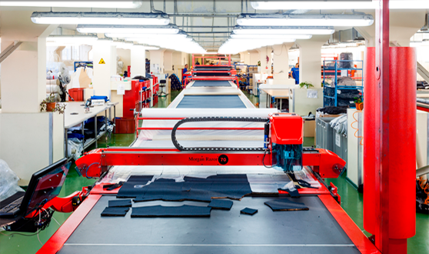
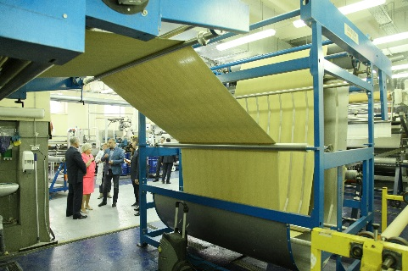
Investment passport of the city district of Lyubertsy
Mostostroyindustriya JSC branch of the Lyubertsy Bridge Construction Equipment Plant is the leading Russian company in the production of inventory casing pipes and related equipment for the construction of bored piles. The plant produces metal structures for spans of road and railway bridges, as well as structures for industrial and civil construction.
CJSC FPG Energocontract specializes in the most reliable protection of personnel of the fuel and energy complex, transport, logging and metallurgical industries of Russia from professional risks.

Slide 15

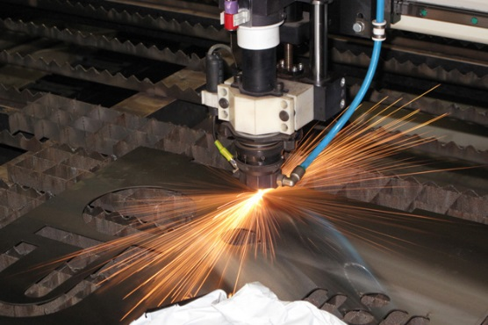
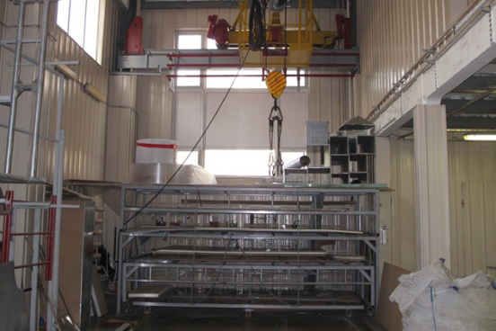

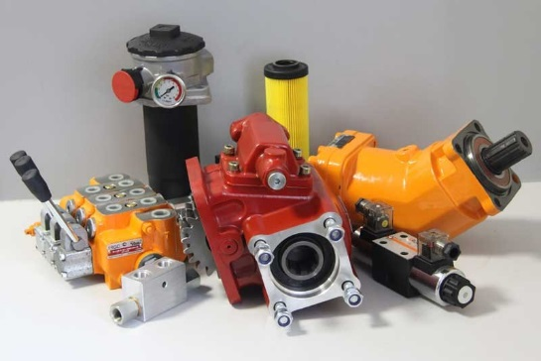
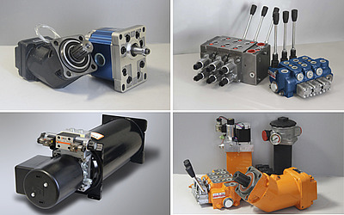

Investment passport of the city district of Lyubertsy
RPK "LaserStil" LLC successfully operates in the advertising market in two main areas: the production of outdoor advertising, facade and interior signs and the production of serial and exclusive POS materials, registration of stationary points of sale.
RG-Remservis LLC carries out the production and professional repair of hydraulic units, as well as the supply of components for hydraulic systems of leading world manufacturers and its own production under the RGC brand.

Slide 16

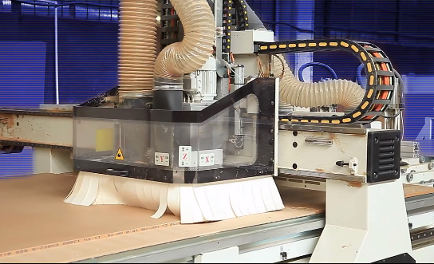
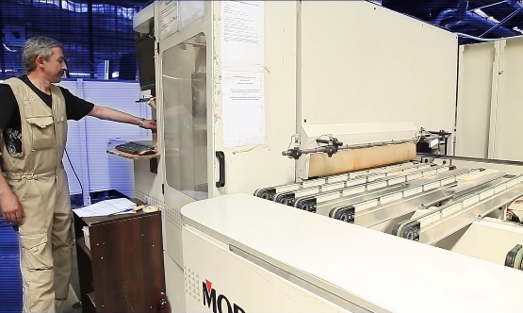

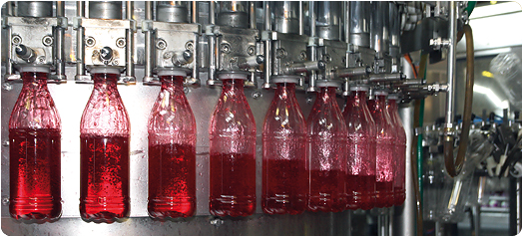
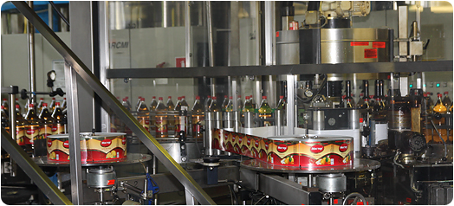
Investment passport of the city district of Lyubertsy
LLC "KD". The company "Kitchen Yard" has a high-tech production of kitchen furniture and sets, based on the automation of all production processes.
LLC PK Leader is an enterprise producing soft drinks of more than 100 kinds of various drinks in almost all existing categories.

Slide 17


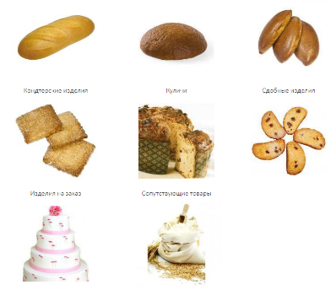

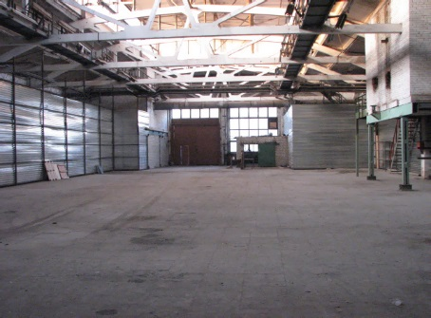
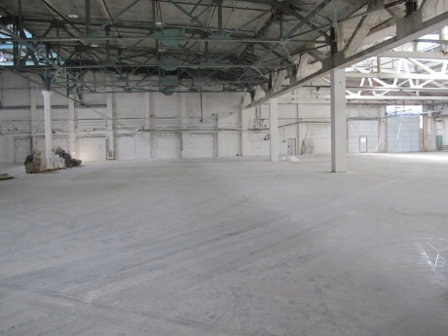
Investment passport of the city district of Lyubertsy
JSC "Lyubertsy Bakery" produces up to 20 kinds of confectionery and 50 kinds of bakery products, such as: bread, loaf products, rich small pieces, cookies, pies, muffins, cakes, oriental sweets, rich crackers in assortment, pancake flour.
LLC DOK-13 is the owner of the production and warehouse complex, and it provides long-term lease of non-residential premises in the territory of the urban district of Lyubertsy.

Slide 18

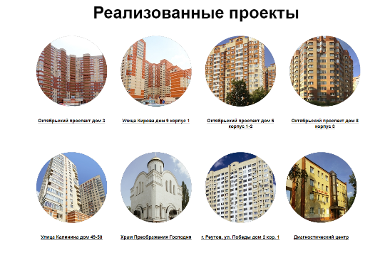
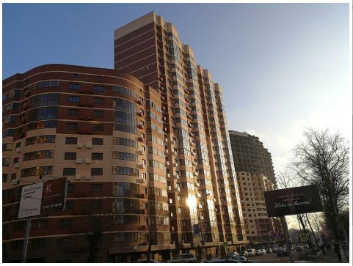

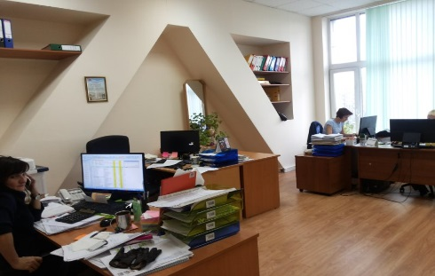

Investment passport of the city district of Lyubertsy
LLC ISK Areal Investment and Construction Company Areal is engaged in the construction of residential complexes and infrastructure facilities, forming a modern urban space.
InterLek LLC is currently a dynamically developing company providing a wide range of drugs, actively working in two directions: distribution throughout the Russian Federation and shipment of Russian products to the CIS countries.

Slide 19


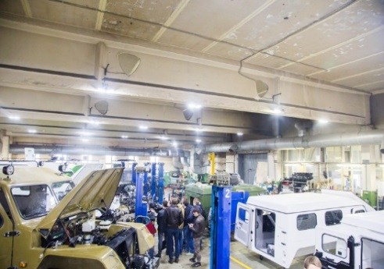

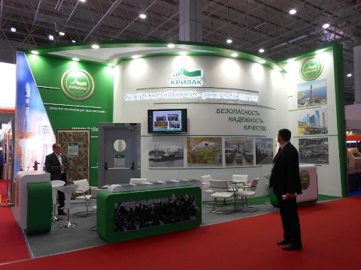

Investment passport of the city district of Lyubertsy
NPF TREKOL LLC develops and manufactures amphibious all-terrain vehicles on ultra-low pressure tires of its own design.
Holding LLC NPO Association Krillak specializes in the development, production and implementation of integrated fire protection systems and fire safety equipment.

Slide 20


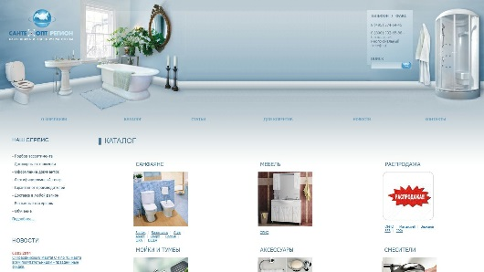

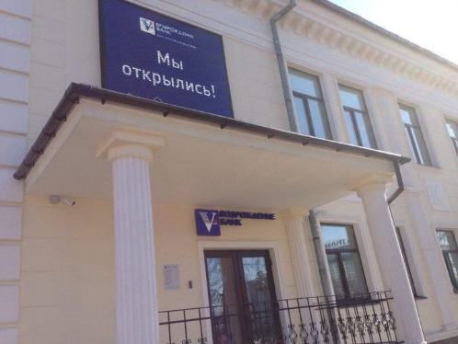
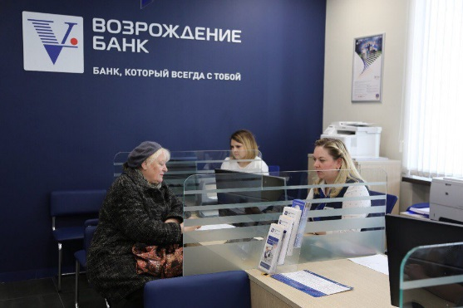
Investment passport of the city district of Lyubertsy
LLC Santechopt-Region provides a large selection of wholesale supplies of household plumbing, pipe fittings, heating and measuring devices, sewer and pumping equipment, sealing materials, plumbing tools and related products.
In the city of. Lyubertsy Bank Vozrozhdenie is represented by 3 branches that serve individuals, legal entities and individual entrepreneurs, and 10 ATMs, of which 6 work around the clock, 4 accept cash.

Slide 21

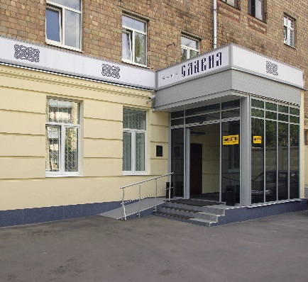
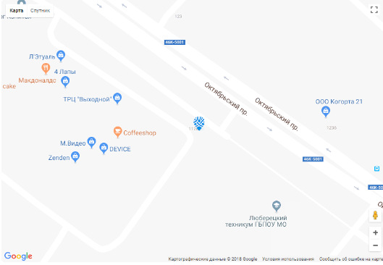
Investment passport of the city district of Lyubertsy
LLC AKB SLAVIA (JSC) Bank provides its clients with a full range of banking services, including cash management services, credit and deposit services, foreign exchange transactions, securities transactions, cash collection, etc.

Slide 22
Investment passport of the city district of Lyubertsy
Thank you for attention

